Slide 1
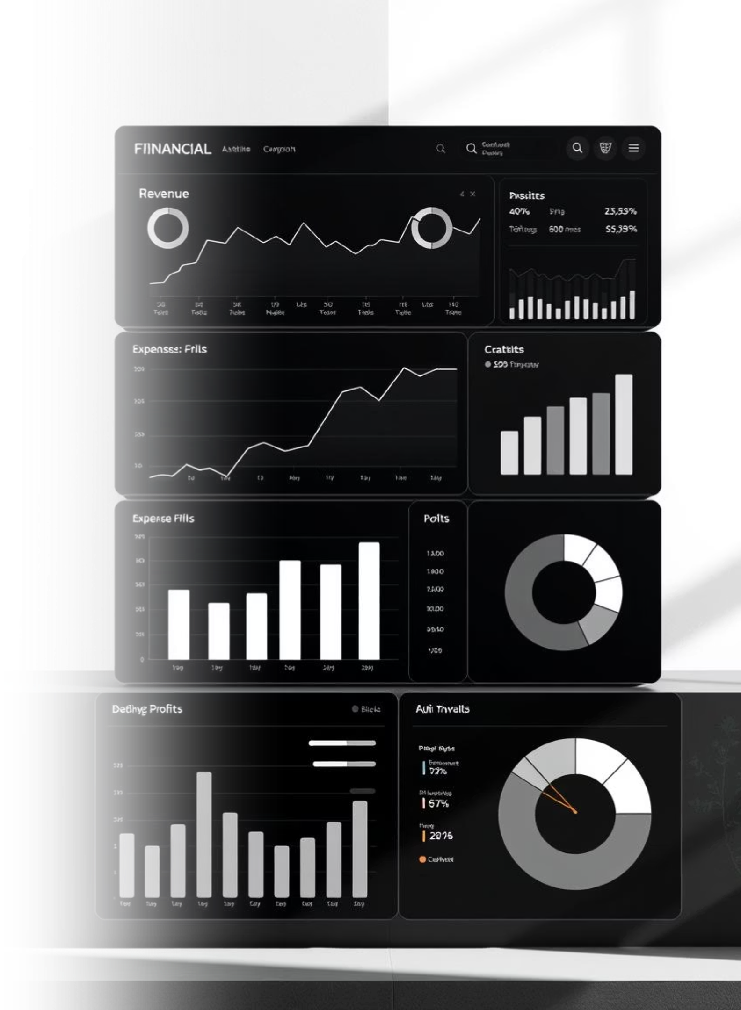
Sales & Finance Dashboard Analysis
Derived from Power BI & Excel Dataset (Financials.csv.xlsx)

Slide 2

Dataset Overview: Your Data at a Glance
The dataset provides comprehensive financial and sales data across various dimensions:
Product Information: Name and category
Geography: Country-wise sales
Customer Segments: Consumer, Corporate, Home Office
This rich data forms the foundation for deep insights into sales performance and profitability.

Slide 3





Dashboard Objectives: Driving Strategic Decisions
The Power BI dashboard was meticulously designed to achieve key business objectives, empowering data-driven decision-making for finance and sales strategy.
Track Trends
Monitor sales and profit fluctuations over time and across segments.
Identify Top Performers
Pinpoint leading products and countries driving revenue.
Analyze Discounts
Visualize the direct impact of discounts on overall profitability.
Enable Interaction
Provide interactive filtering and drill-down capabilities for users.

Slide 4
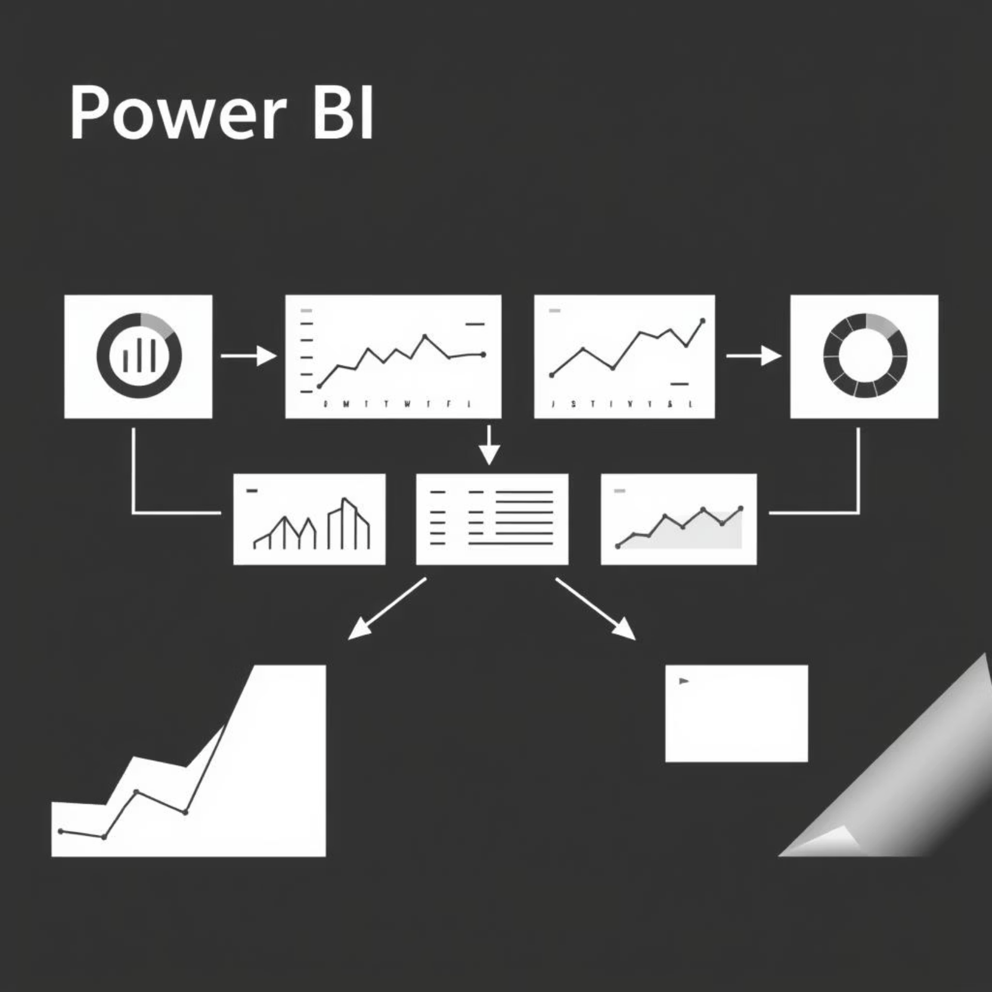
Dashboard Layout: A Holistic View
The dashboard is structured for clarity and interactivity, offering a comprehensive snapshot of business performance.
Bar Charts: Sales by Product, Profit by Country
Line Graphs: Monthly sales/profit trends
Cards/KPIs: Total Sales, Total Profit, Average Discount
Slicers: Segment, Country, Date Range

Slide 5

Key Metrics & KPIs: Performance at a Glance
These primary metrics are crucial for understanding and evaluating business performance, visually represented for quick comprehension.
Total
Total
Avg.
Sales
Profit
Discount
Measures gross revenue generated.
Indicates the overall business earnings.
Shows the average discount offered.
%
Profit Margin
Derived for efficiency understanding.

Slide 6
Key Insights & Trends: Data-Driven Discoveries
Analyzing the dashboard reveals critical patterns and relationships that inform strategic planning and operational adjustments.
Profit vs. Sales
High-profit products don't always equate to high sales volume, highlighting strong margins.
Segment Performance
Corporate and Consumer segments consistently outperform Home Office.
Geographic Dominance
Countries like the USA lead in both sales and profitability.
Discount Impact
Increased discounts often correlate with reduced profit margins.
Monthly Fluctuations
Trends show seasonality, valuable for inventory and staffing.

Slide 7
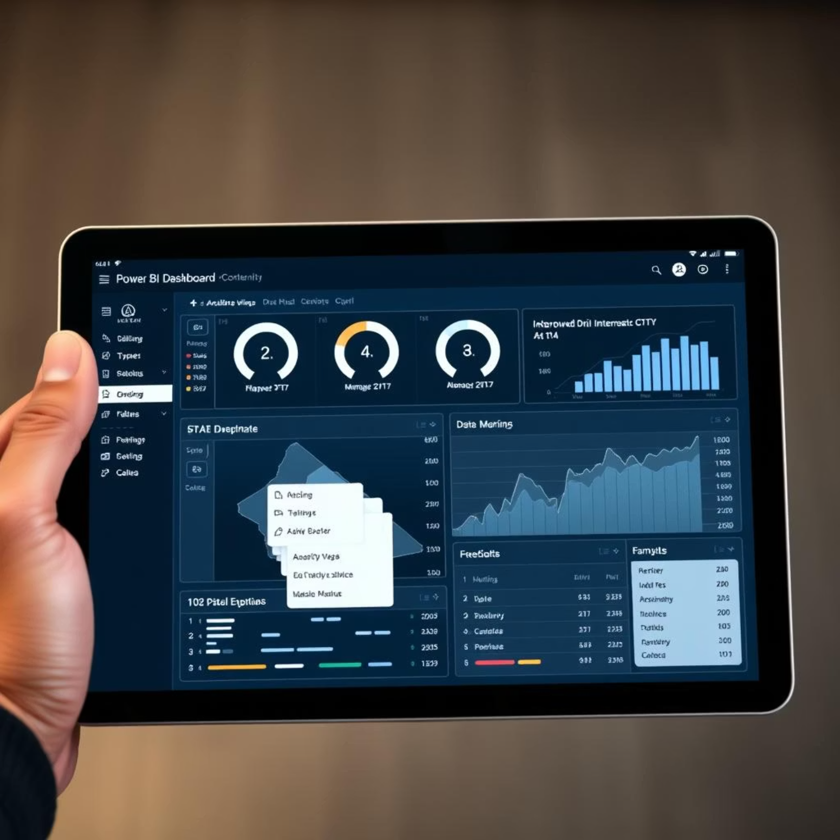
Interactive Elements: Dynamic Data Exploration
Power BI's interactive features allow users to delve deeper into the data, asking specific questions and receiving instant visual feedback.
Slicers for Filtering: By Country, Segment, Product Category
Drill-down Capabilities: From Year → Quarter → Month for detailed analysis
Hover Tooltips: Display detailed information without visual clutter
Real-time Updates: Dynamic visual responses to user interactions

Slide 8

Business Recommendations & Next Steps
Leveraging these insights, we propose actionable strategies for optimizing performance and enhancing future dashboard capabilities.
Recommendations:
Next Steps:
Invest more in high-margin products.
Automate data refresh processes.
Revise discount policies in low-profit areas.
Integrate forecasting models.
Target underperforming segments with new strategies.
Add customer-level granularity.
Expand in profitable countries.
Use monthly trends for operational planning.

